Slide 1

Stock Market Prediction using Granger’s causality test as a data pre-processor
By,
Akshay Dhonthi Ramesh Babu - 1887502
Fabian Humberto Fonseca Aponte - 1886565
David Esteban Imbajoa Ruiz - 1922212
Academic Year 2019 − 2020

Slide 2
Introduction
The stock market fluctuation is too rough and sometimes unpredictable even with proper tools and indicators. However, the future price prediction of a financial asset is essential for investors.
The near future prediction can reduce the risk on decision of an appropriate investment asset. This kind of prediction can lead to gain in steady incomes.
Over the decade, large number of techniques has been developed out of which RNN has shown a great improvement converging into LSTM thanks to the data driven decision making.
Many times, the stocks of certain companies depend on others. Finding the correct causation between the companies may help in better predictions.

Slide 3
Objective
The presentation will cover the following section of the project:
Problem Statement: The purpose of the project.
Methodology: Methods and algorithms used
Experiments: Hypotheses and partial results of the performed experiments.
Results and Conclusion: Final results obtained and evaluation of the performance of the implementation.

Slide 4
Problem Statement
Explore the different alternatives for a stock market prediction that considers the possible relations between companies and compare the results obtained

Slide 5

Dataset - Yahoo Finance
The dataset is loaded directly into python from Yahoo Finance using their API.
A select number of companies (approx. 100) are chosen in advance.
Each company has four time series data columns (open, high, low and close).
The dataset is structured into single data frame with all the companies.
The original dataset is modified with respect to the needs or the possible augmentation of its information.

Slide 6
Methodology
Feature Engineering
Formatting of the data
Data augmentation with stock market related variables and PCA
Preliminary Development
Prediction with LSTM - Individual
Prediction with LSTM - Combined
Causation Matrix Development
Granger Causality test
Correlated Development
Prediction with LSTM - Filtered
Experiments with BERT

Slide 7
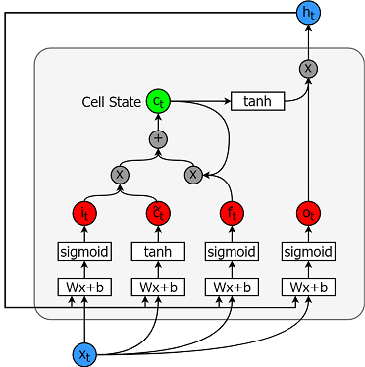
Methodology - LSTM
The LSTM is a special kind of RNN which is able to keep long term dependencies and in-turn solve the vanishing gradient problem
The advantage of using LSTM is its ability to process sequential data.
Each line carries an entire vector, from the output of one node to the inputs of others.
The grey circles represent pointwise operations, like vector addition, while the white boxes are learned neural network layers

Slide 8
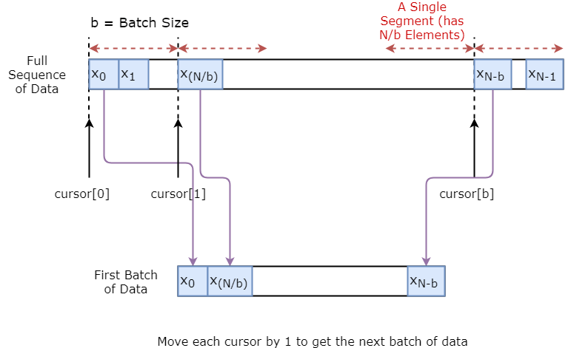
Methodology - LSTM (Data Generator)
The basic idea is that we divide the data sequence to N/b segments.
Define cursors, 1 for each segment.
To sample a single batch of data, we get one input and one true prediction.
At the end of each sampling, we increase the cursor by 1.
Final number of batches depends on the user-defined time step.

Slide 9
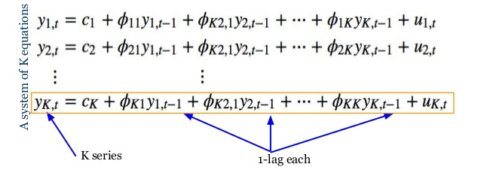
Methodology - Causation Matrix
Vector Autoregressive Model
This VAR model is a linear combination of past values of itself and the past values of other variables in the system.
As there are multiple time series that influence each other, VAR is modeled as a system of equations with one equation per time series.
For example, If there are two time serie, two compute one time series, the past values of both time series is used.
Image from: https://www.slideshare.net/databricks/time-series-forecasting-using-recurrent-neural-network-and-vector

Slide 10
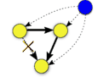
Methodology - Causation Matrix
Granger’s Causality Test
The idea behind VAR is to predict the series with past values of itself along with other series in the system.
Granger’s causality tests the null hypothesis that the coefficients of past values in the regression equation is zero
Image from: https://link.springer.com/chapter/10.1007/978-1-84996-196-7_5

Slide 11
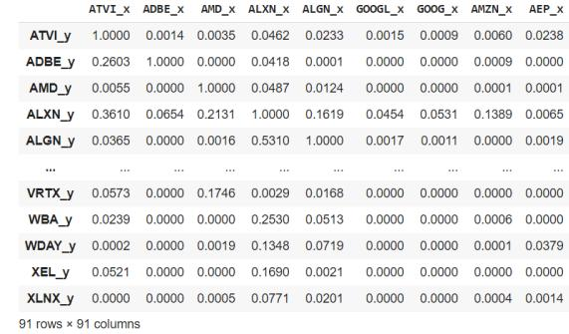
Implementation - Granger’s Causality test
The test is to check granger causality of all possible combinations of the n Time series. Where n is the number of companies.
The test returns an nXn matrix. With the rows being the time series in interest and the columns being the company to check if it affects the time series in interest based on the past values of both.
If the significance level is less than 0.05, then the the column time series does not cause the row time series.

Slide 12
Implementation
Custom databases
Extended features DB: Includes all the features extracted from the original columns provided by the Yahoo Finance API [open, high, low, close].
Extended by companies DB: Uses the most relevant features from all the companies and integrate its columns to the dataset to find external support on the prediction.
Filtered Company DB:
Use the causation matrix to estimate the companies with the highest contribution to the predicted company and from them the Dataset used is extended.

Slide 13
Implementation - Extended features DB
(BBANDS)
Bolligin bands
(SMA)
Simple moving average.
(MACD)
moving average convergence/divergence.
(RSI)
Relative Strength Index.
(KDJ)
Stochastic Oscillator
The indicators are calculated from time series data adjusted to eliminate artificial price or volume shocks.

Slide 14
Implementation - Extended by company DB
4 Features from Yahoo Finance
(Close, High, Low, Open)
4 Features/Company
Total: 4*98 = 392
Normalization
Range: 0 to 1
98 Total Companies
Each Company
Reduced features from the PCA allows to integrate external factors such as companies from the sector.
The network should be able to recognize the internal relationships between companies during the training and consider it in the weights.

Slide 15
Implementation - Filtered by causation matrix DB
4 Features from Yahoo Finance
(Close, High, Low, Open)
Granger’s Causality Test on one feature: ‘Close’
Take top 10 companies showing causality on the selected company
98 Total Companies
98X98 Causation Matrix
Each Company
Normalization
Range: 0 to 1
4 Features/Company + 10 features from causality test
Total: 4 + 10*4 = 44
Using a filter is possible reduce the stress in the training by not including all the companies from the web scraping.
The causation matrix will ensure that the data feeded into the network comes from the most related companies.

Slide 16
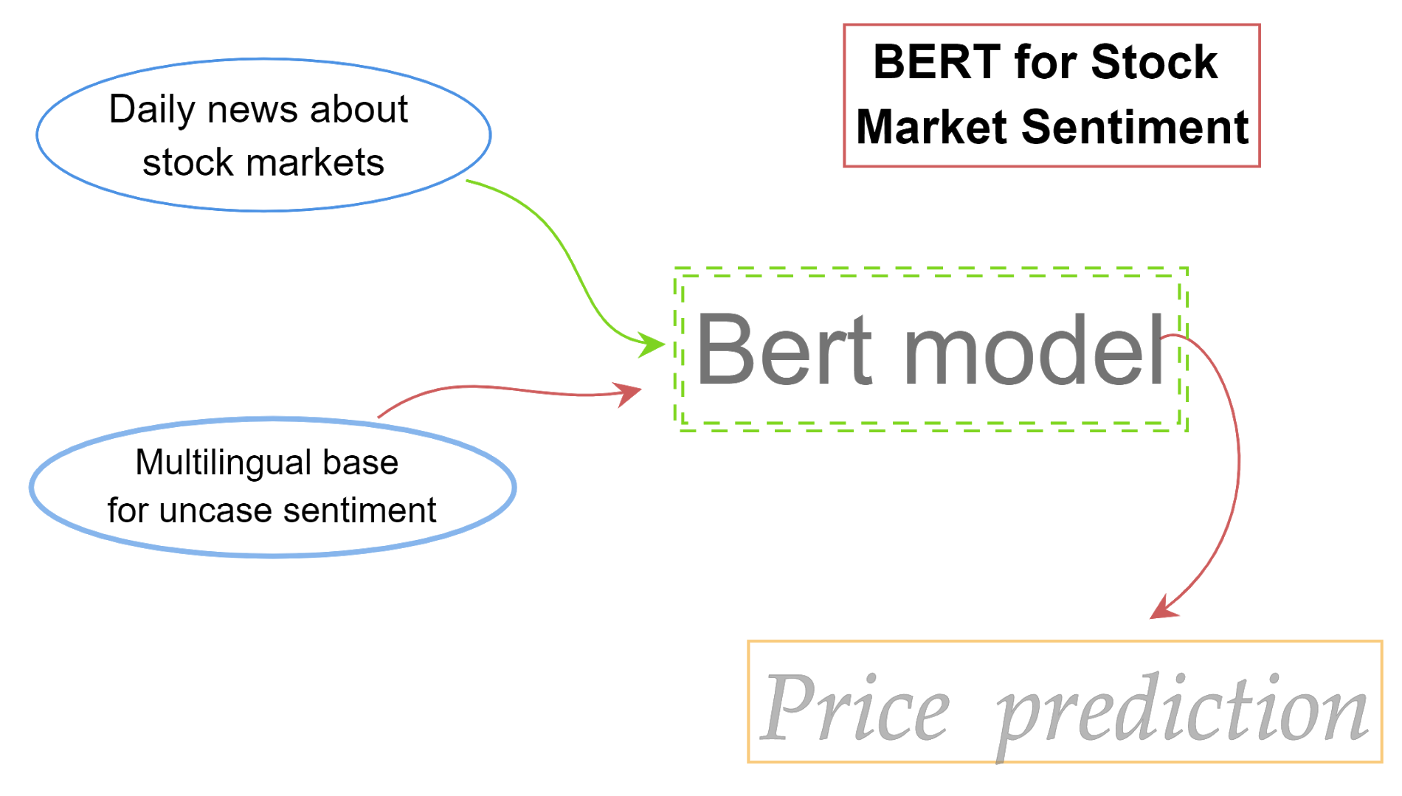
Experimentation- BERT Predictor
The data analysis evaluates the financial news mood before the stock market opening time
This model is pre-trained on a large amount of general-domain documents by means of a self-learning task (BERT - base - multilingual - uncased - sentiment).
For daily news searching were used the libraries googlesearch and newsplease.

Slide 17
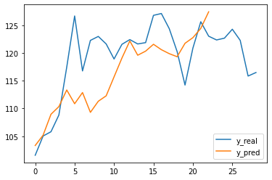
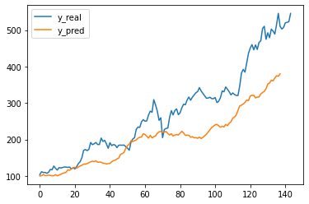
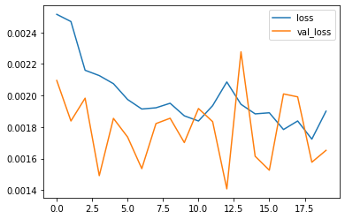
Experimentation - BERT Predictor
Training
Testing
Tesla

Slide 18
Experimentation - Expected Results
Single company: Limited performance due to the missing information from external variables
Extended by companies: Expensive training due to the large amount of information included, but with better performance due to the external factor included
Initial Development
Implemented properly it will provide a reference to associate companies that may influence the behaviour of the predicted one
Causation Matrix Development
The preprocessing step of filtering the unrelated companies will reduce the resources needed to train and provide a better context of the external factors
Filtering with Causation Matrix

Slide 19
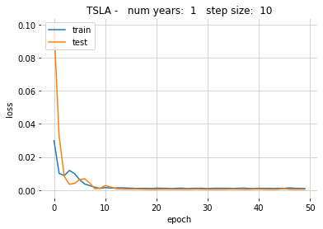
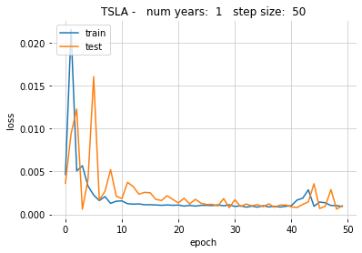
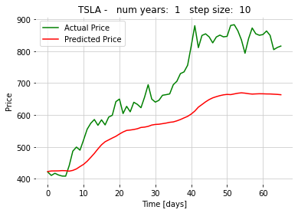
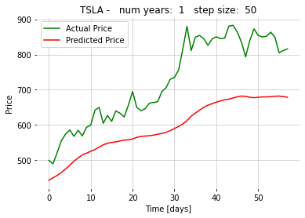
Experimentation - 1 Year Single
Company: Tesla Duration: 1 year Time step: 50, 10 steps Batch size: 64 windows Feature set: Single Epochs: 50

Slide 20
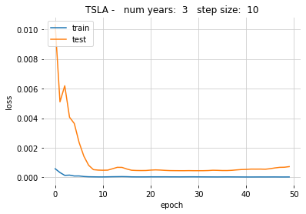
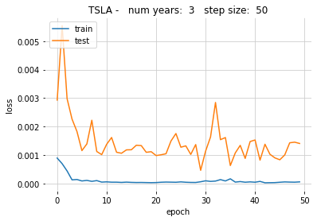
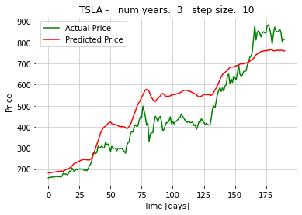
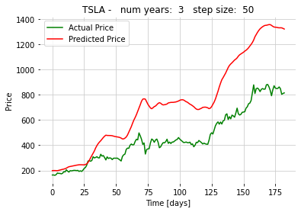
Experimentation - 3 Years Single
Company: Tesla Duration: 3 years Time step: 50, 10 steps Batch size: 64 windows Feature set: Single Epochs: 50

Slide 21
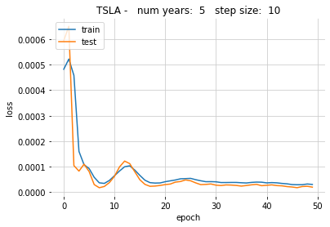
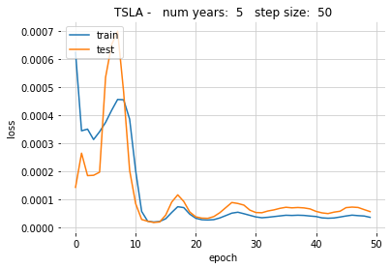
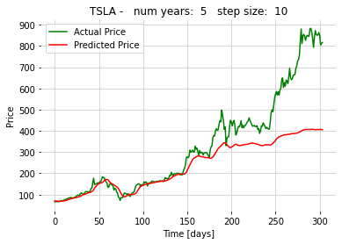
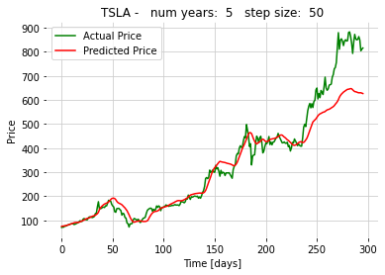
Experimentation - 5 Years Single
Company: Tesla Duration: 5 years Time step: 50, 10 steps Batch size: 64 windows Feature set: Single Epochs: 50

Slide 22
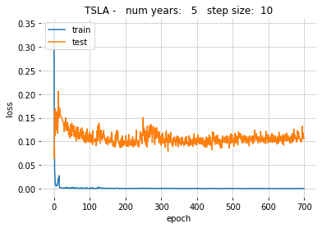
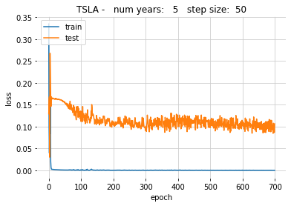
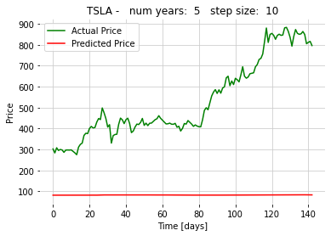

Experimentation - 5 Years Extended
Company: Tesla Duration: 5 years Time step: 50, 10 steps Batch size: 64 windows Feature set: Extended Epochs: 700

Slide 23
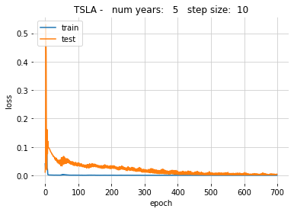
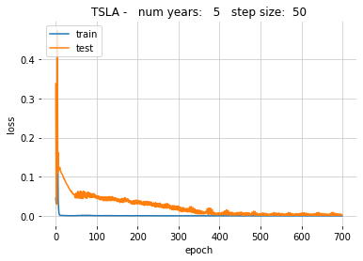
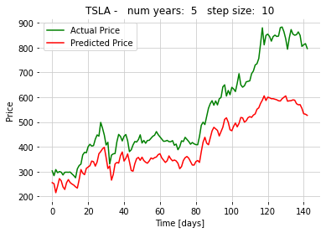
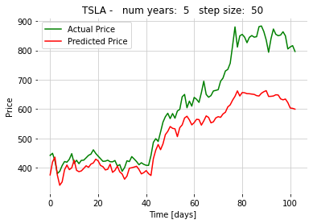
Experimentation - 5 Years Filtered
Company: Tesla Duration: 5 years Time step: 50, 10 steps Batch size: 64 windows Feature set: Filtered Epochs: 700

Slide 24
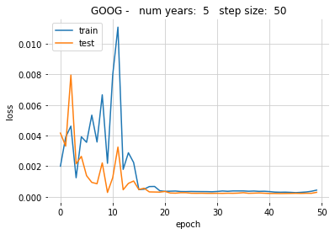
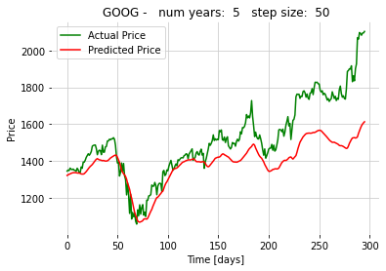
Results - Best Predictor (Single Company 5 Years)
The best predictor turned out to be the single company approach with 5 years.
The training process with a different company (Google) was successfully held with similar results.
The training process has differences in the loss profile proving independence from the design process and robustness.

Slide 25
General results
There are several approaches to extend the reach and scope from the database used, all related but not limited with feature engineering techniques.
The inclusion of external factors like behavior from external companies is possible in several levels.
The normalization process has a strong influence in the overall performance.
Database influence
The complexity of the training process and the required model depends greatly on the database used.
For the present case of this project a reduced database has the best quality/demands ratio.
The final result is in some degree independent from the predicted company.
Performance metrics

Slide 26
Conclusion
The purpose of the project is for stock market prediction with different approaches and feature engineering techniques which is successfully implemented
Four approaches are developed and their respective experiments and results are been briefly formulated
The innovation in this project is to use causation matrix to filter and involve multiple companies past data as a training feature and see how it affects the training process which is achieved
The experiments are conducted for three training durations 1, 3, and 5 years respectively
Although, the best prediction is obtained with the single company, we can see huge difference in training with companies filtered based on the Granger’s causation test instead of training with random companies.
Further improvement can be seen if the Granger’s test can be performed in continuous state which require large computation time

